Slide 1
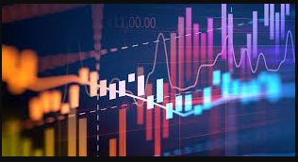
ACQUIRING NASCENT SKILLS FOR EMERGING OIL AND GAS OPPORTUNITIES: DATA ANALYTICS, MACHINE LEARNING AND ARTIFICIAL INTELLIGENCE

Slide 2


Acquiring Nascent Skills for Emerging Oil & Gas Opportunities: Data Analytics, Machine Learning & Artificial Intelligence
OUTLINE
Introduction: Era of Data
DA, ML & AI: What are they?
Data Analytics (DA)
Machine Learning (ML)
Artificial Intelligence (AI)
DA, ML & AI: Knowledge Base
Statistics & Mathematics
Computer Programming
Data Visualization
DA, ML & AI: Oil & Gas Applications
Oil and Gas Data
Applications
Company Examples
DA, ML & AI: How to Acquire the skills?
Working Platforms
Learning Resources
Conclusions

Slide 3


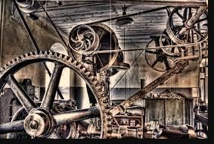

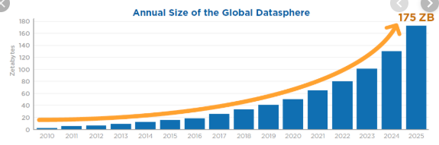
Acquiring Nascent Skills for Emerging Oil & Gas Opportunities: Data Analytics, Machine Learning & Artificial Intelligence INTRODUCTION
Era of Data
It is the age of data. Data is everywhere!!!
Stone age
Iron age
Industrial age
Electronic age
Data age
Technology makes it possible to capture and store vast quantities of data
Amount of data is growing. 2.5 billion gigabytes of data generated everyday in 2012. [1]
Source: IDC Data Age 2025 Whitepaper

Slide 4



Acquiring Nascent Skills for Emerging Oil & Gas Opportunities: Data Analytics, Machine Learning & Artificial Intelligence
INTRODUCTION
Era of Data
Data versus Information
Data: recorded facts.
Information: patterns, trends, insights and relationships that underlie data
Information is what is needed for decision-making and problem-solving processes.
The process of extracting information from data is generally known as Data Mining (DM). The required body of knowledge is Data Science (DS).
Data Analytics (DA), Machine Learning (ML) and Artificial Intelligence (AI) are all parts of Data Science

Slide 5

Acquiring Nascent Skills for Emerging Oil & Gas Opportunities: Data Analytics, Machine Learning & Artificial Intelligence
DA, ML & AI: WHAT ARE THEY?
Data Analytics
Data Analytics: a set of tasks performed on data with the aid of specialized systems and softwares in order to describe or infer the information contained in such data.
DA tasks include:
Data collection – identifying sources, subsetting, assembling
Data integration – combining data from different sources into a common format
Data preparation – manipulating and organizing data to conform it to analytics requirements
Data cleaning – fixing quality problems: errors, suspicious, omitted and duplicated data
Data modeling – fitting data into conventional models: linear regression etc.
Data visualization – presenting data with charts, graphs to aid information mining
Data interpretation

Slide 6
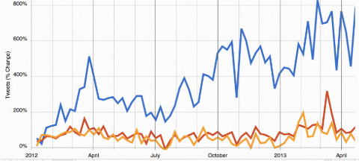
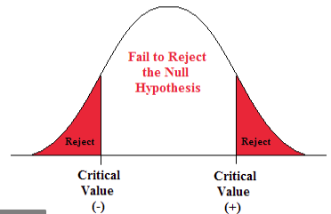

Acquiring Nascent Skills for Emerging Oil & Gas Opportunities: Data Analytics, Machine Learning & Artificial Intelligence
DA, ML & AI: WHAT ARE THEY?
Data Analytics
Data analytics could be exploratory or confirmatory
Exploratory Data Analysis (EDA): finds patterns and relationship – more like the work of a crime investigator [2]
Confirmatory Data Analysis (CDA): determines if hypothesis are true or false – more like the work of a judge [2]

Slide 7

Acquiring Nascent Skills for Emerging Oil & Gas Opportunities: Data Analytics, Machine Learning & Artificial Intelligence
DA, ML & AI: WHAT ARE THEY?
Machine Learning
Machine learning refers to techniques by which machines (computers) are made to analyze data and recognize (learn) patterns and trends in data without relying on standard rule-based programming practices.
Core of ML: making machines perform tasks based on past experiences passed to the machines as training data
ML could handle larger and more complicated data and could find patterns more quickly than conventional data analytics tools.
ML requires less human effort and less assumptions .
A subfield of computer science and AI

Slide 8


Acquiring Nascent Skills for Emerging Oil & Gas Opportunities: Data Analytics, Machine Learning & Artificial Intelligence
DA, ML & AI: WHAT ARE THEY?
Machine Learning
Machine learning types/algorithms includes:
Regression
Classification
Clustering
Dimensionality reduction
Feature extraction
Decision tree
Random forest
K-nearest neigbors.
Two major approaches to machine learning:
Supervised learning – train with labeled (input/output) data – to predict output for new inputs. Examples – regression, classification.
Unsupervised learning – train with unlabeled data – to detect patterns. Examples – clustering analysis.

Slide 9

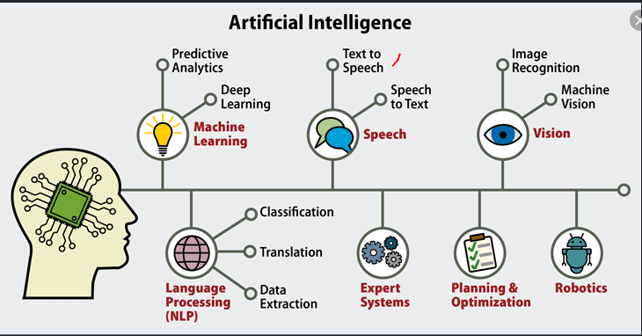
Acquiring Nascent Skills for Emerging Oil & Gas Opportunities: Data Analytics, Machine Learning & Artificial Intelligence
DA, ML & AI: WHAT ARE THEY?
Artificial Intelligence
Artificial intelligence (AI) is a sub-discipline of computer science with focus on developing machines (computers) capable of performing tasks requiring human intelligence.
AI systems work by learning (from data) and improving performance over time.
Major application areas of AI includes: machine learning (ML), natural language processing (NLP), computer vision (CV), speech recognition, virtual assistants etc.
Source: datamation.com

Slide 10




Acquiring Nascent Skills for Emerging Oil & Gas Opportunities: Data Analytics, Machine Learning & Artificial Intelligence
DA, ML & AI: KNOWLEDE BASE
Certain domains of knowledge are necessary to attain competence in DA, ML & AI
Computer Programming
Often, there will be the need to write codes to implement workflows for specific datasets and objectives.
For automation and flexibility
Statistical programming language like R and data querying language (SQL)
Mathematics and Statistics
Matrix (linear) algebra: forms the basis of many ML techniques
Multivariable calculus
Data distributions, statistical estimators, hypothesis tests
Data Visualization
Turning numeric data to visual objects aids communication and decision making process.
Understanding the principles of visual encoding of data.
Creativity, critical and intuitive thinking, and problem solving skills also needed

Slide 11
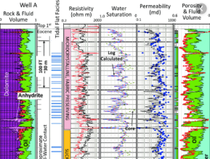
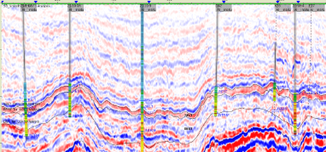

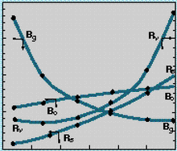
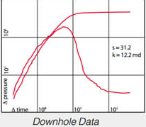
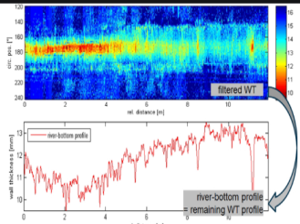
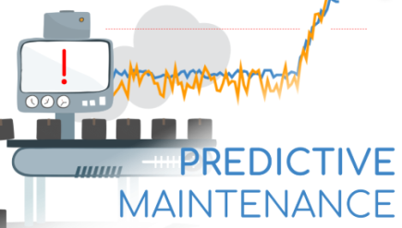
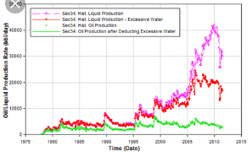
Acquiring Nascent Skills for Emerging Oil & Gas Opportunities: Data Analytics, Machine Learning & Artificial Intelligence
DA, ML & AI: OIL AND GAS APPLICATIONS
The oil and gas sector is prolific in data generation and measurements.
Data items include:
Seismic surveys
Well logs
Core data
Fluid data
Pressure and temperature data
Production test data
Production and injection data – volumes, rates
Drilling performance data
Pipeline inspection data
Equipment maintenance and failure data
Crude trading data
Oil and Gas Data

Slide 12
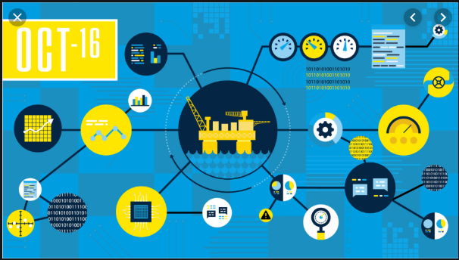
Acquiring Nascent Skills for Emerging Oil & Gas Opportunities: Data Analytics, Machine Learning & Artificial Intelligence
DA, ML & AI: OIL AND GAS APPLICATIONS
Applications
Resource estimation – using AI to predict reserves
Subsurface modeling and analysis – using ML to find correlations among geological variables
Wells analysis – historical and real-time well data analysis
In-fill drilling – using AI to optimize number and locations of wells
Well trajectory optimization – sensors and AI tools

Slide 13

Acquiring Nascent Skills for Emerging Oil & Gas Opportunities: Data Analytics, Machine Learning & Artificial Intelligence
DA, ML & AI: OIL AND GAS APPLICATIONS
Applications
Drill bit performance monitoring
Fluid properties – using ML algorithms to develop correlations
Production optimization – using computer vision to analyse
Equipment monitoring and maintenance – pumps, compressors; using AI to predict unexpected failures
Crude logistics and trading – oil grade data, price and market data

Slide 14

Acquiring Nascent Skills for Emerging Oil & Gas Opportunities: Data Analytics, Machine Learning & Artificial Intelligence
DA, ML & AI: OIL AND GAS APPLICATIONS
Applications
Investment portfolio management – using AI/ML to evaluate opportunities
Health, Safety and Environment – using AI/ML to perform root cause analysis
Inventory management – using AI/ML to predict demands, stock levels, warehouse utilization etc
Finance – using AL/ML for cost allocations

Slide 15








Acquiring Nascent Skills for Emerging Oil & Gas Opportunities: Data Analytics, Machine Learning & Artificial Intelligence
DA, ML & AI: OIL AND GAS APPLICATIONS
Company Examples
Baker Hughes & NVIDIA – to use AI-based to help clients gain insights from data
Total and Google – AI systems to help geologists interpret subsurface images
ExxonMobil and MIT – autonomous underwater exploration robots
BP invested in start-up Belmont Tech – developing a geoscience platform - “Sandy”

Slide 16





Acquiring Nascent Skills for Emerging Oil & Gas Opportunities: Data Analytics, Machine Learning & Artificial Intelligence
DA, ML & AI: HOW TO ACQUIRE THE SKILLS
Working Platforms
Here are some platforms on which DA/ML/AI workflows can be implemented. Most of them are open source platforms
R – a statistical programming environment – preferred for data science
Python – a programming environment – popular among data science practitioner
SAS
SQL – database management
IBM Watson – AI platform

Slide 17






Acquiring Nascent Skills for Emerging Oil & Gas Opportunities: Data Analytics, Machine Learning & Artificial Intelligence
DA, ML & AI: HOW TO ACQUIRE THE SKILLS
Working Platforms
Scikit-learn – ML platform on Python
ggplot2 – visualization in R
Matplotlib – visualization in Python
Apache Hadoop – Big data platform
Apache Spark
Tableau – analytics and data visualization

Slide 18




Acquiring Nascent Skills for Emerging Oil & Gas Opportunities: Data Analytics, Machine Learning & Artificial Intelligence
DA, ML & AI: HOW TO ACQUIRE THE SKILLS
Working Platforms
Google Analytics
MSExcel
Knime
Weka

Slide 19

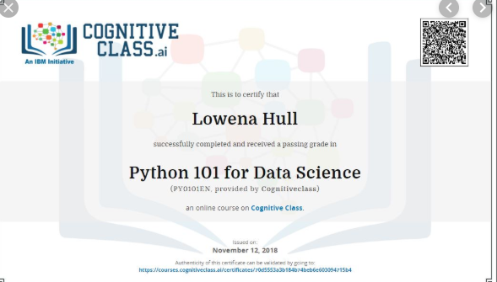


Acquiring Nascent Skills for Emerging Oil & Gas Opportunities: Data Analytics, Machine Learning & Artificial Intelligence
CONCLUSION
Learning Resources
There is abundance of learning resources from which DA, ML & AI skills could be learnt. Many of these resources are open access. You could earn recognized certificates and badges on some of these platforms
Data Camp
Coursera
IBM – Digital Nation Africa

Slide 20





Acquiring Nascent Skills for Emerging Oil & Gas Opportunities: Data Analytics, Machine Learning & Artificial Intelligence
DA, ML & AI: HOW TO ACQUIRE THE SKILLS
Learning Resources
Big Data University
Cognitive Courses
edX
MIT OCW
Kaggle – a community of data scientists – contain lots of data

Slide 21
Acquiring Nascent Skills for Emerging Oil & Gas Opportunities: Data Analytics, Machine Learning & Artificial Intelligence
CONCLUSION
DA, ML and AI are technologies that would certainly impact the oil and gas value chain in the emerging future. In order to leverage on this, young graduates should acquire these skills.

Slide 22
Acquiring Nascent Skills for Emerging Oil & Gas Opportunities: Data Analytics, Machine Learning & Artificial Intelligence
THANK YOU FOR LISTENING!!!

Slide 23
Acquiring Nascent Skills for Emerging Oil & Gas Opportunities: Data Analytics, Machine Learning & Artificial Intelligence – Orodu, O. D
BIBLIOGRAPY
Ralph Jacobson (2013). IBM Consumer Products Industry Blog, https://www.ibm.com/blogs/insights-on-business/consumer-products/2-5-quintillion-bytes-of-data-created-every-day-how-does-cpg-retail-manage-it/
Tukey, J. W. (1977). Exploratory data analysis. Reading, MA: Addison-Wesley.

